Slide 1
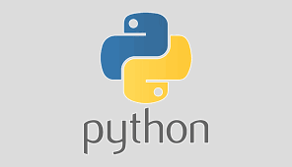
Behave tutorials for
BDD with Python

Slide 2
Agenda
What is Behave (in Python programming)?
Keywords used in Behave
Feature file
Step, Step Definition, Step Implementation
Installation details
Parameterization (int, string, dataTable, examples)
Before/ After Decorators
Runner file with command line arguments
Reporting (JSON format pass/ fail) using Allure module
Reporting (HTML format) using json2html module

Slide 3
What is Behave (in Python programming)?
It is a testing framework which is used in Behaviour Driven Development (BDD) based testing.
Using Behave we can define application behaviour in plain English text.

Slide 4
Keywords used in Behave
Given
When
And
Then
But
Scenario
Scenario Outline
Background
Examples, (Table)
Feature

Slide 5
Feature file
A file with .feature extension
A place user can write different scenario in plain English statements in short called as steps
Example
Sample project structure
features/
features/search_product.feature
features/add_to_cart.feature
features/payment_type.feature
features/environment.py
features/steps/
features/steps/user_action.py
features/steps/utilities.py
features/Runner.py

Slide 6
Step, Step Definition, Step Implementation
Step – Smallest individual action by user written in English
Step Definition – Actual testing implementation for each step i.e. actual automation code pertaining to each step
Step Implementation – Detailed automation code with many small, small pieces of code to achieve particular functionality

Slide 7
Parameterization
Passing parameter from feature file
Numeric (Int/ Float)
String
Using Examples, (Table)
Receiving/ parsing parameters
Automatically generate step definition code

Slide 8
Decorators (Before/ After)
Advised to be coded in environment.py(coming soon)
before_step(context, step),
after_step(context, step)
before_scenario(context, scenario),
after_scenario(context, scenario)
before_feature(context, feature),
after_feature(context, feature)
before_tag(context, tag),
after_tag(context, tag)
before_all(context),
after_all(context)
Notes:
before_step(context, step), after_step(context, step) These run before and after every step.
before_scenario(context, scenario), after_scenario(context, scenario) These run before and after each scenario is run.
before_feature(context, feature), after_feature(context, feature) These run before and after each feature file is exercised.
before_tag(context, tag), after_tag(context, tag) These run before and after a section tagged with the given name. They are invoked for each tag encountered in the order they’re found in the feature file.
before_all(context), after_all(context) These run before and after the whole shooting match.
The feature, scenario and step objects represent the information parsed from the feature file.
They have a number of attributes:
keyword “Feature”, “Scenario”, “Given”, etc. name The name of the step (the text after the keyword.)
tags A list of the tags attached to the section or step. See controlling things with tags. filename and line The file name (or “”) and line number of the statement.

Slide 9
Runner file
FrameworkRunnerwithReporting file (.py) (Pythonic way of running program) Starting point of our Python Selenium BDD based framework which will trigger out feature file and generate the JSON2HTML report at specified location
Command line arguments:
command line options
Specific/ grouped feature files
--no-capture
--no-capture-stderr
--tags
-f plain ➔ plain text output
Notes:
Configuration files for behave are called either “.behaverc”, “behave.ini”, “setup.cfg” or “tox.ini” (your preference) and are located in one of three places:
the current working directory (good for per-project settings),
2. your home directory ($HOME), or
3. on Windows, in the %APPDATA% directory. Tags --tags=tag99 ➔ only tag99
--tags=-tag99 ➔ except tag99
--tags=tag1,tag2 ➔ tag1 OR tag2
--tags-tag1 --tags=tag2 ➔ tag1 AND tag2

Slide 10
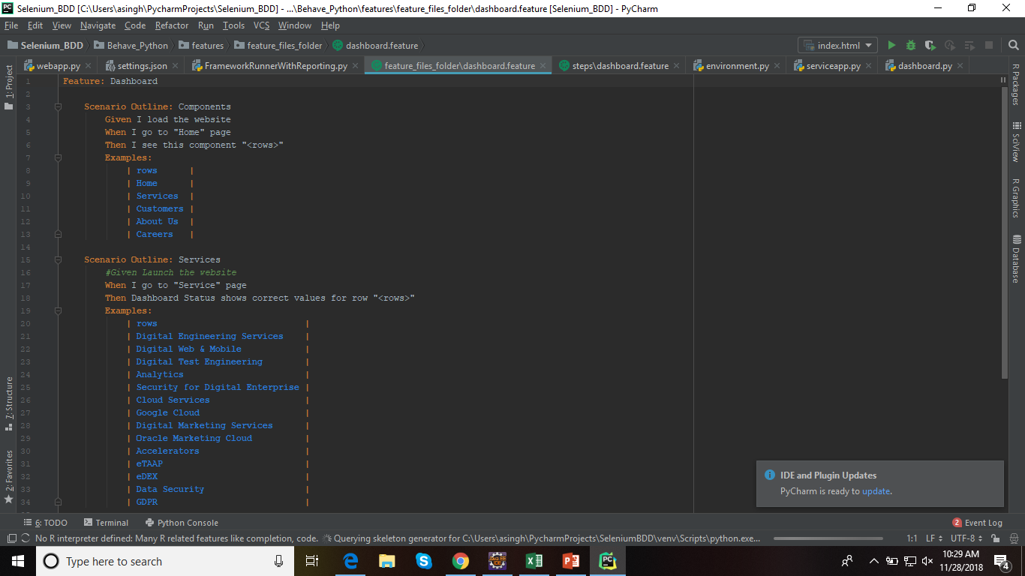


Slide 11
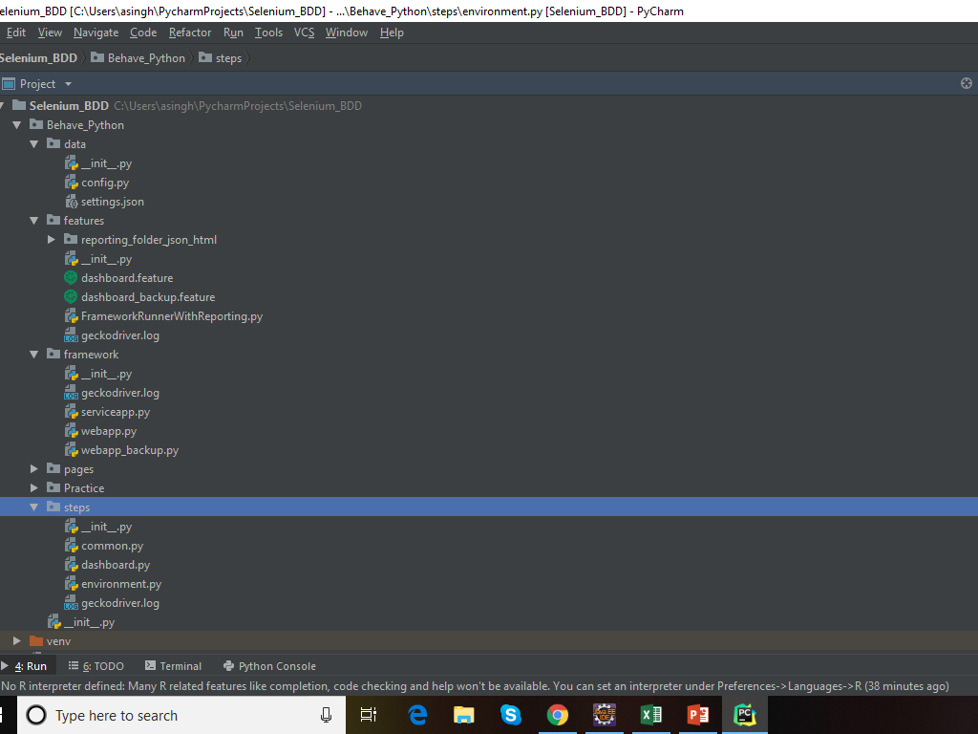

Slide 12
Reporting (JSON) using Allure module
Install Allure modules
Add following command line arguments in runner file
-f allure_behave.formatter:AllureFormatter –o <<folder_name>>
Reporting (HTML) using json2html module
Install and import json2html module
Add following after Allure behave finishes json format results
json2html.convert(json = <<json_from_allure_results>>)

Slide 13



References :
Selenium Python Bindings Release 2 Baiju Muthukadan
Selenium An Introduction to Python and the Selenium Module Patrick Messina

